Slide 1

Flights analysis
Alahly Team (Team 29)

Slide 2
Role of each member
Abanoub:
Data cleaning and (Operations Analytics lead)
Ahmed Hussein:
Data warehouse and data dictionary and (Predictive maintenance & safety excellence)
Alaa:
Revenue & Competitive positioning analyst
Ahmed Fathy:
Financial performance & regulatory analyst
Abdalla:
customer experience & brand analyst

Slide 3
Project Idea & Objective
Business Challenge
Our Solution
Flight delays impact billions in costs annually
Unscheduled maintenance reduces aircraft availability
Weather disruptions propagate through airline networks
Lack of integrated analytics for decision-making
Centralized flight operations database
Real-time KPI monitoring dashboards
Predictive maintenance insights
Network-wide delay propagation tracking

Slide 4
Core Project Objectives
1. Data Integration: Build a star-schema data warehouse consolidating flight operations, maintenance, airport, and weather data from 5M+ flight records (2015 dataset)
2. Analytics Engine: Develop 11+ advanced SQL queries answering critical business questions across maintenance, delays, weather, and network operations
3. Executive Dashboard: Create interactive Power BI/Tableau visualizations enabling real-time KPI monitoring and trend analysis
4. Decision Support: Provide actionable insights for operations, maintenance, and revenue management teams to optimize on-time performance

Slide 5

Operation dashboard

Slide 6
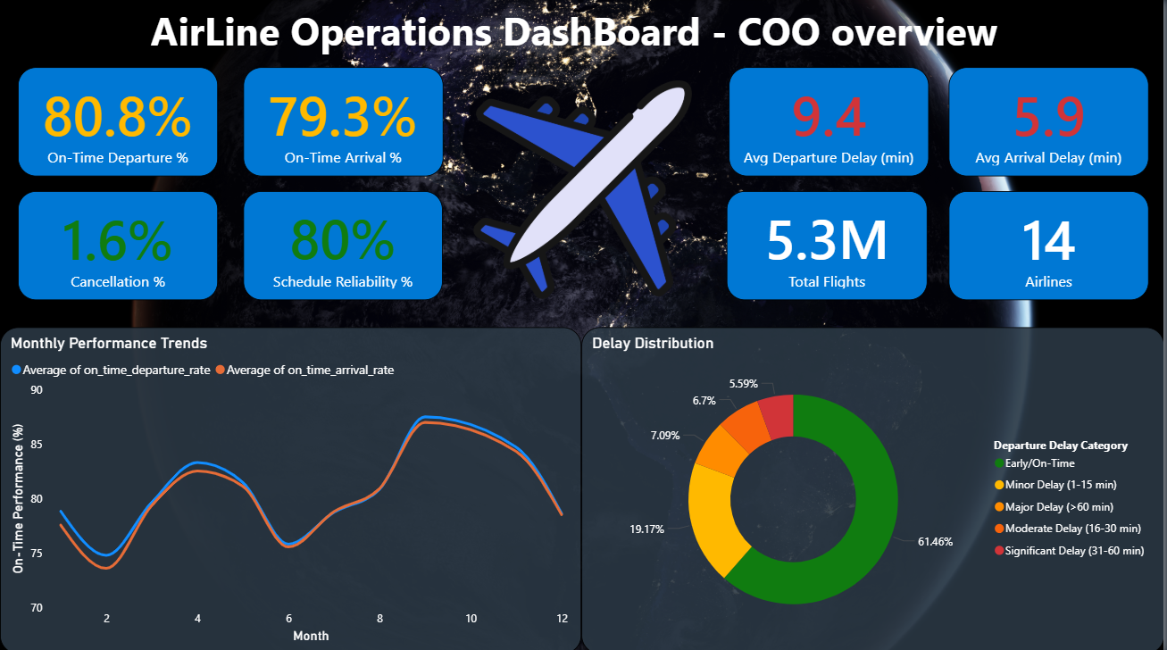

Slide 7
Maintenance Dashboard

Slide 8
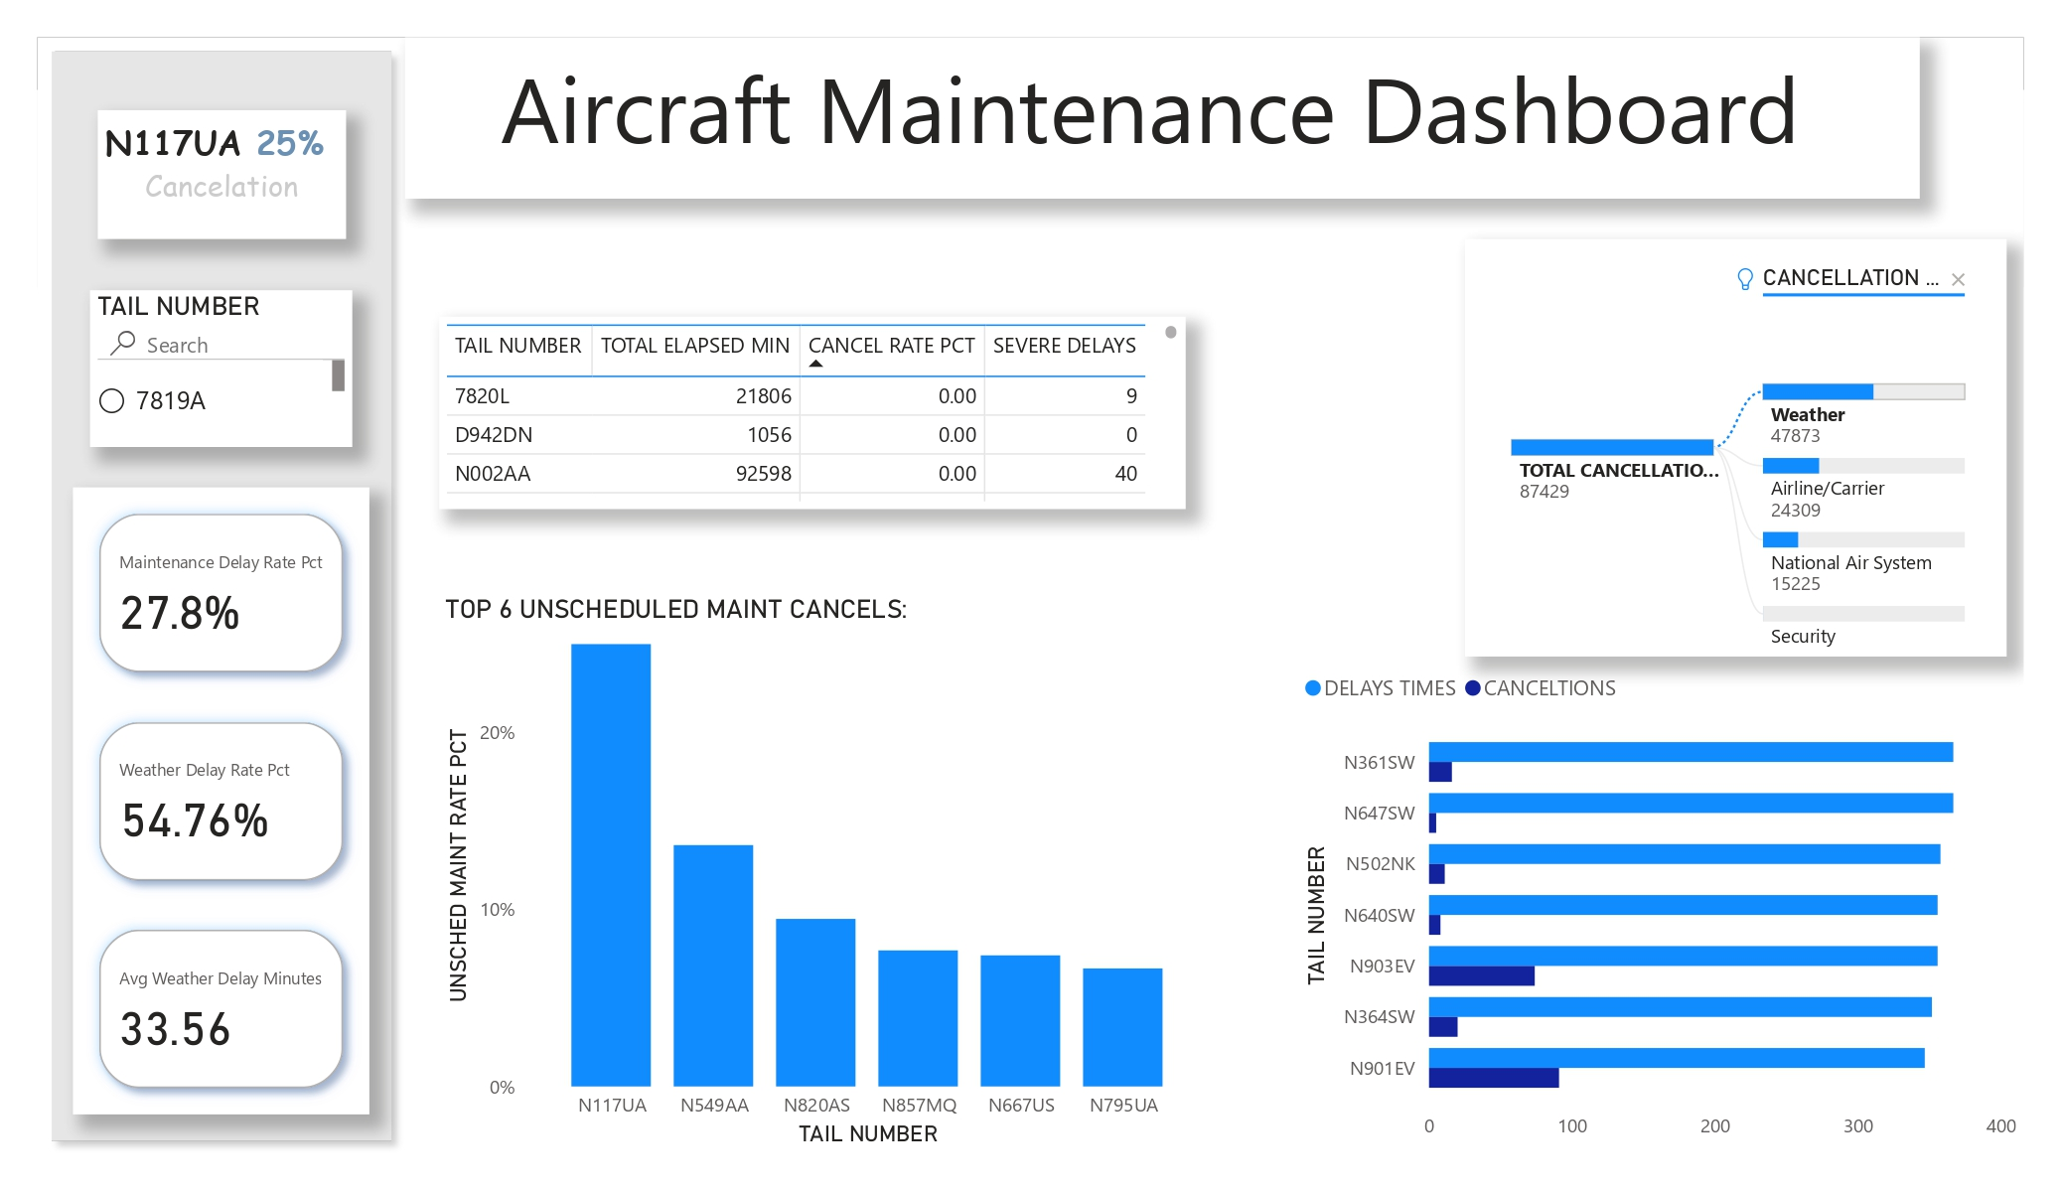

Slide 9
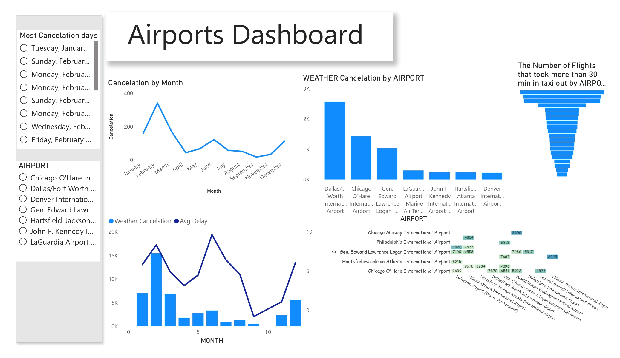

Slide 10
Performance Dashboard

Slide 11
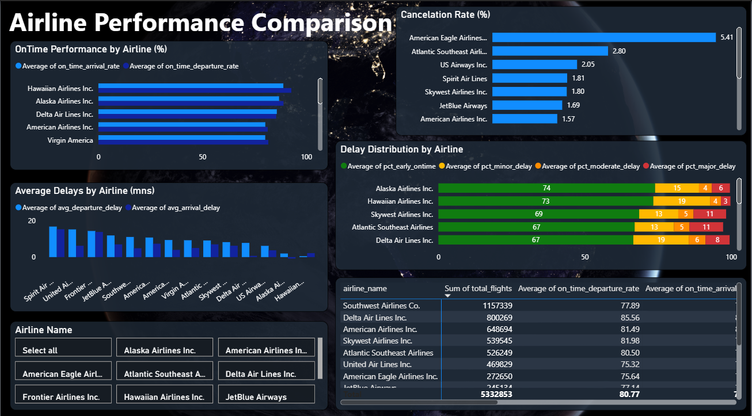

Slide 12
Time analysis

Slide 13
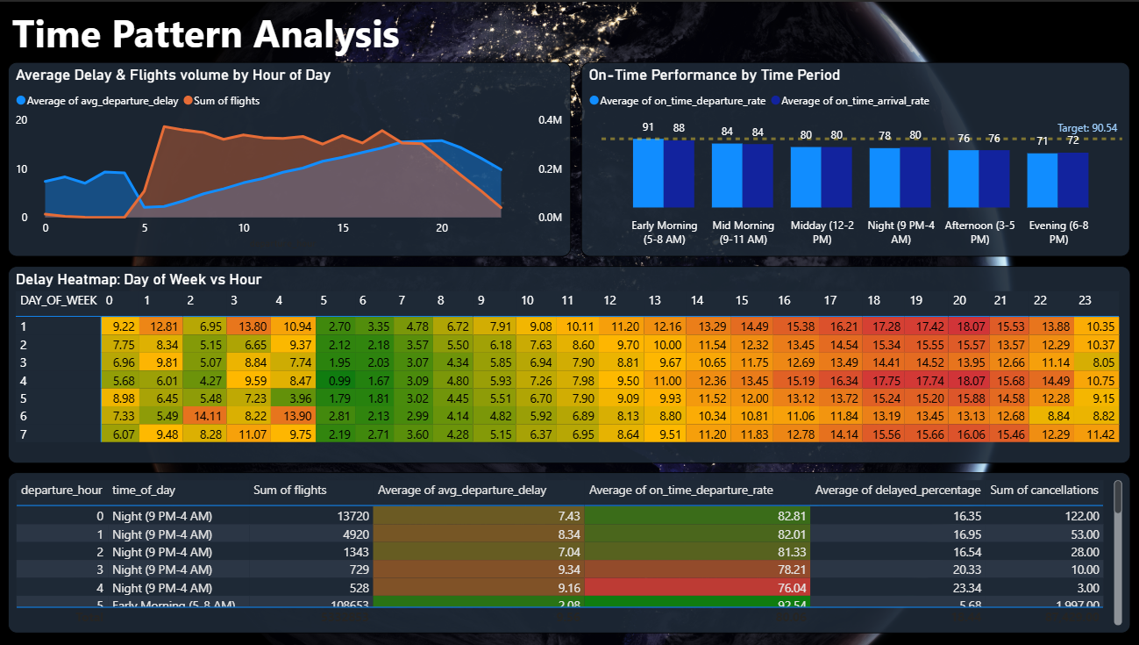

Slide 14
Seasonal analysis

Slide 15
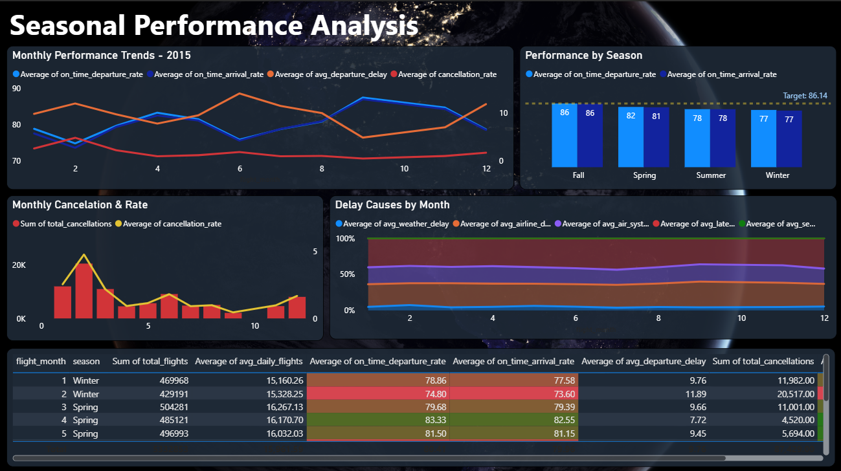

Slide 16
Operation Performance

Slide 17
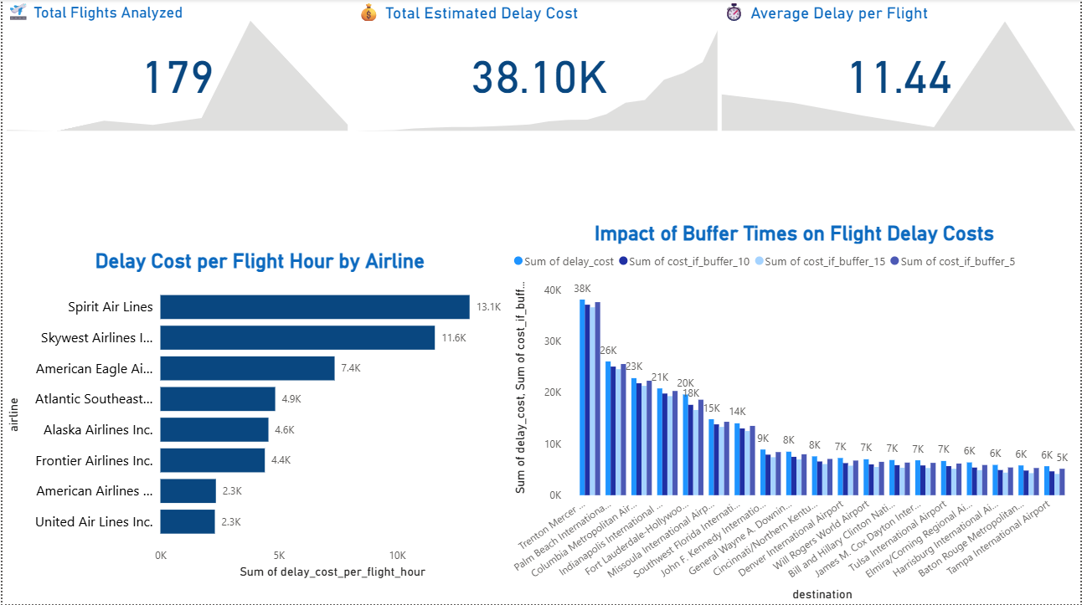

Slide 18
Revenue risk

Slide 19
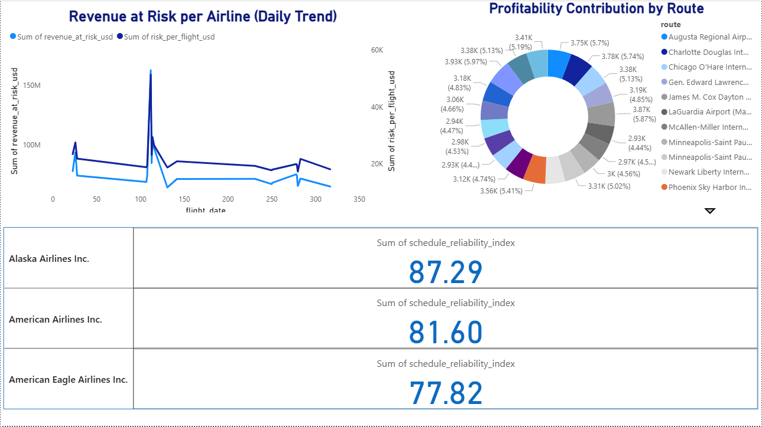

Slide 20
Business Impact & Value Proposition
Cost Reduction: Identify high-maintenance aircraft early, reduce cancellations (save $10K-50K per cancellation prevented)
Operational Efficiency: Optimize maintenance scheduling, reduce unplanned downtime by 15-25%
Customer Satisfaction: Reduce delays through predictive insights, improve on-time performance metrics
Data-Driven Decisions: Empower operations teams with real-time KPIs replacing manual reporting

Slide 21
Future Development Roadmap
Phase 1: Enhanced Analytics (Q1-Q2 2026)
• Real-Time Data Integration: Connect live flight operations feeds (OOOI timestamps, real-time maintenance logs)
• Predictive Modeling: ML models for failure prediction (MTBF forecasting, delay propagation modeling)
• Component-Level Analytics: Engine, hydraulics, avionics failure rates and trend analysis

Slide 22
Future Roadmap (Continued)
Phase 2: Monetization & Commercialization (Q2-Q3 2026)
• SaaS Product: Cloud-based platform for regional carriers, charter operators, MRO facilities
• API Services: RESTful APIs for maintenance predictions, delay forecasting, route optimization
• Consulting Services: Expert analysis packages (network optimization, fleet management, cost reduction)

Slide 23
Marketing & Growth Strategy
Market Segments:
1. Regional Airlines: 200+ operators worldwide needing cost optimization (TAM: $50M+)
2. Maintenance Providers: MRO facilities (scheduled maintenance optimization)
3. Airport Operations: Ground support optimization, slot utilization
4. Data Analytics Consultancies: White-label partnership opportunities

Slide 24
Go-to-Market Strategy
Distribution Channels:
Direct sales to airline operators (vertical SaaS)
Partnership with aviation software vendors (integration)
Industry conference presence (IATA, ICAO events)
LinkedIn & technical community engagement
Pricing Model: Per-aircraft-per-month SaaS ($500-2,000/aircraft) + implementation fees

Slide 25
Technology Stack & Scalability
Data Layer: MySQL/PostgreSQL (on-prem) → Cloud migration (AWS RDS, Snowflake)
Analytics: Advanced SQL, Python for ML pipelines, R for statistical modeling
Visualization: Power BI / Tableau / Looker (enterprise BI tools)
Scalability Path: Support 50+ airlines, 10,000+ aircraft, 500M+ annual flights by 2027

